Slide 1
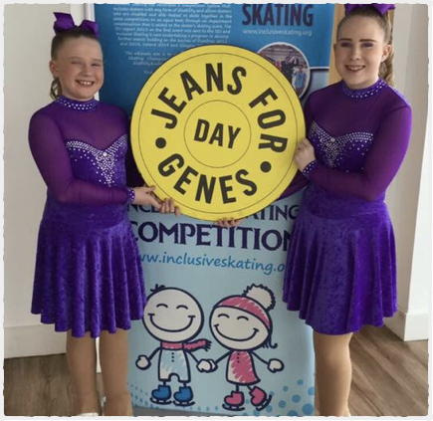
Inclusive Skating for Genes British Championships 2017
First event for those with genetic disorder as a group - 1 in 25 children in the UK affected by a genetic condition
65% of solo competitors had clear genetic condition arising in childhood or SWANS
Many disadvantaged by other classification systems e.g. Cystic Fibrosis or Downs Syndrome or BBS

Slide 2
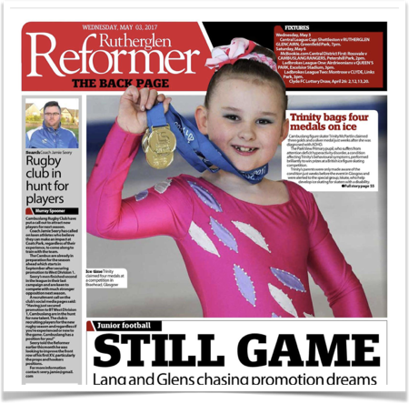
British Inclusive Skating Unified Championships 2017
Inclusive skaters who are eligible and have 0 to <5% impairment compensation
Skaters can fall between able bodied and disabled systems
Development of all skaters in supportive environment

Slide 3
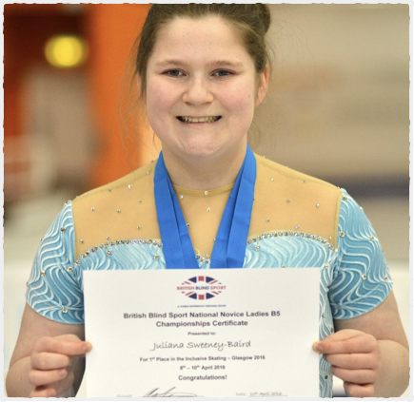
Inclusive Skating
Low Cost
event development program
Inclusive Skating Championship results derived by comparison of 1 minute performance score
Multiple disability specific results for same performance, E.g.
British Blind Sport Championships
Special Olympics
IS for Genes Championships
Unified Championships
Future Paralympic classes, Deaflympics etc.

Slide 4
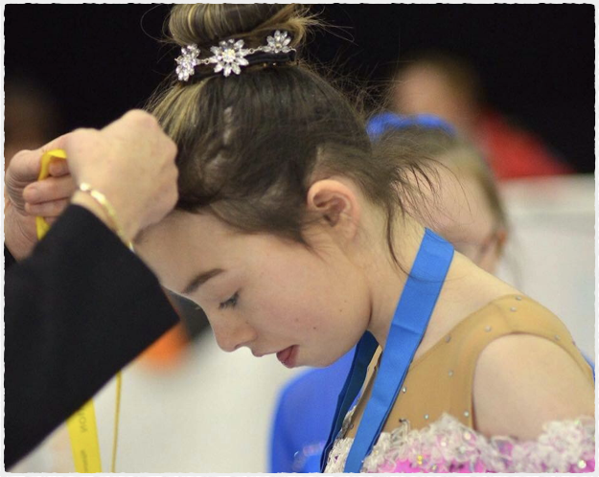
Inclusive Skating events – novel features
Low risk accreditation and facilitation policies
Events structured around the skater
Low cost event development
New sources of funding
New communities – children with genetic disorders, Unified etc. who are difficult to get into sport now take part
Disabled get to choose a sport they love!

