Slide 1
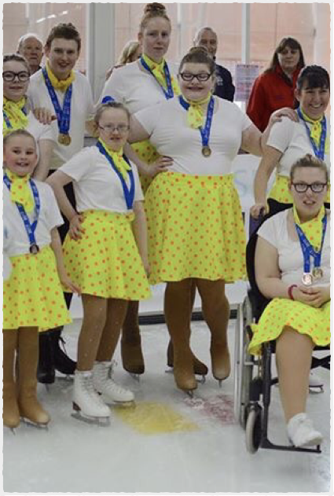
Policy recommendations
Classify all disability: Include everyone
Support Inclusive clubs / Community
(Include carers/ family)
IS accreditation = more safe inclusion
IS facilitation = more safe inclusion
IS rule adaptation = FUN!
Inclusive Olympics? Welcome new opportunities!

Slide 2
Contacts & video links to IS youtube videos
http://www.inclusiveskating.org
https://www.youtube.com/channel/UCdkgP0YdS99OYr0gz7vwWdA
https://www.facebook.com/BBCLookNorthYorkshire/videos/10155118674224626/
https://www.youtube.com/watch?v=jpLrcakUQMw
https://www.youtube.com/watch?v=S74fclTRvtk
Margarita.msb@gmail.com

